Slide 1
GIS and RS for Forest Resource Assessment
Kefyalew Sahle Hawassa University
Wondo Genet College of Forestry and Natural Resources
GIS Department

Slide 2
Unit 7. Forest Fires monitoring

Slide 3
Content
Remote sensing types for active forest fire monitoring
Remote sensing types for monitoring areas damaged by forest fire
Detecting Fires
Mapping Burned Areas
Monitoring burnt areas
Indices for Danger Assessment. .

Slide 4
Climate and Wildfires
Fires reflect a complex connection between weather and climate conditions and ecosystem processes.
Numerous studies have indicated that fire frequency, spatial extent, and duration show a close association with climate variability on seasonal to interannual and decadal time scales .
Climate change, along with the variability, is also considered responsible for increasing fire activities worldwide.
Increasing temperature due to climate change and resulting dry and warm conditions influence fire activities.

Slide 5
Climate Variability & Change and Fire Weather
Fire weather is a combination of temperature, precipitation, winds, and humidity conducive to high potential of fire activities.
Climate conditions influence fire weather, soil moisture, and vegetation productivity, affecting fire activities.

Slide 6
Precipitation and Wildfires
Excessive precipitation during the growing season increases vegetation growth that becomes fuel for fire in the subsequent dry season.
Pre-fire season rainfall and number of rainy days in fire seasons affect wildfire extent and severity
Precipitation patterns and amount affect surface temperature and soil moisture which also impact pre-fire risk.

Slide 7
Soil Moisture and Wildfires
Pre-fire season soil moisture anomalies (departure from long-term mean) help assess risk of wildfires.
It has been noted that in arid regions, wetter soil moisture anomalies promote vegetation growth that can fuel fires. In humid regions, dry soil moisture anomalies generally precede fires.
Consecutive wet and dry soil moisture conditions promote wildfires. Normalized soil moisture anomalies at (a) 5 months and (b) 1 month before the month with the largest burned area. Grid cells are grouped with respect to long-term temperature and aridity. Median values across grid cells in each box are shown. Boxes with less than 25 grid cells are discarded and shown in gray. Black dots within the boxes denote significant anomalies at the 90%-level.

Slide 8
NASA remote sensing and Earth system models
NASA remote sensing and Earth system models provide weather, climate, and hydrology data for pre- fire, during-fire, and post-fire conditions.
Precipitation
Soil Moisture
Temperature
Humidity
Winds
Vegetation
Topography

Slide 9
Remote Sensing and Modeling Data For Monitoring Weather, Climate, and Hydrology Conditions
Global Precipitation Measurement (GPM) Mission
Soil Moisture Active Passive (SMAP)

Slide 10
Fire Danger
Fire Danger: “A general term used to express an assessment of both fixed and variable factors of the fire environment that determine the ease of ignition, rate of spread, difficulty of control, and fire impact.”
Fire Danger Rating: “A component of a fire management system that integrates the effects of selected fire danger factors into one or more qualitative indices of current protection needs.”
Topography: Fires spread faster uphill. Fuels are drier on sun-facing slopes.
Fuels: Fire ignitions and behavior depend on the amount, structure, and condition of vegetation.
Weather: Weather controls fuel moisture and fire spread.

Slide 11
Remote sensing and fire
Remote sensing data products provide an opportunity to analyze metrics like vegetation health, extent, moisture, and density, all of which impact fire ignition and behavior.
Land cover and vegetation indices are a means to identify and evaluate fire fuels at a landscape scale.
This information provides a fuel- based input into fire risk assessment.

Slide 12
Fire Risk Mapping
Comprehensive fire risk maps are challenging to produce due to the many factors that impact the probability of fire.
Remotely sensed observations can assist with the estimation of biophysical influences on fire.
The parameters covered can be used as inputs into fire models and risk assessments to incorporate the influence of fuels and topography on likelihood and behavior.

Slide 13
Elements of Vegetation-Based Landscape monitoring
Vegetation Type and Extent: Land Cover Classification, Fractional Cover (FC)
Vegetation Stage and Health: Phenology, Vegetation Health Indices
Vegetation Moisture Content: Moisture Indices, Radar Measurements
Vegetation Structure: Density, Height
Topography: Elevation, Slope, Aspect, Features

Slide 14
Land Cover Classification
Fuel behavior varies with vegetation type. - Example: Forests contain more biomass to sustain burning, but shrubland vegetations often ignites easier.
Classification of a landscape differentiates available fuel types and maps their spatial extent.

Slide 15
Fractional Cover (FC)
Calculated from a land cover classification
Provides regional or countrywide estimates of vegetation fuel types
Useful for aggregation of fuel types with similar burn potential

Slide 16
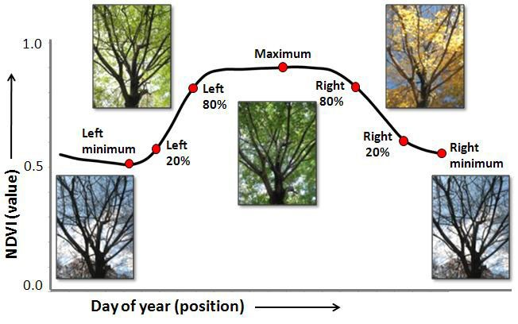
Vegetation Stage and Health
Unhealthy vegetation has a higher percentage of dead branches and leaves, providing easier to burn fuel for fires. The stage of vegetation also dictates the amount and type of fuel available for fires.
Vegetation Stage – Land Surface Phenology (LSP):” Use of satellites and sensors to track seasonal patterns of variation in vegetated land surfaces

Slide 17
Monitoring Stage and Health – Indices:
NDVI - Normalized Difference Vegetation Index
EVI - Enhanced Vegetation Index
SAVI - Soil-Adjusted Vegetation Index
Vegetation index anomalies

Slide 18
Normalized Difference Vegetation Index (NDVI)
NDVI is widely used as a metric for vegetation health and phenology.
A measure of vegetation greenness
Values range from -1.0 to 1.0
Negative values to 0 mean no green leaves.
Values close to 1 indicate the highest possible density of green leaves.

Slide 19
NDVI Formula:
(Near-Infrared – Red)//( Near-Infrared + Red)

Slide 20
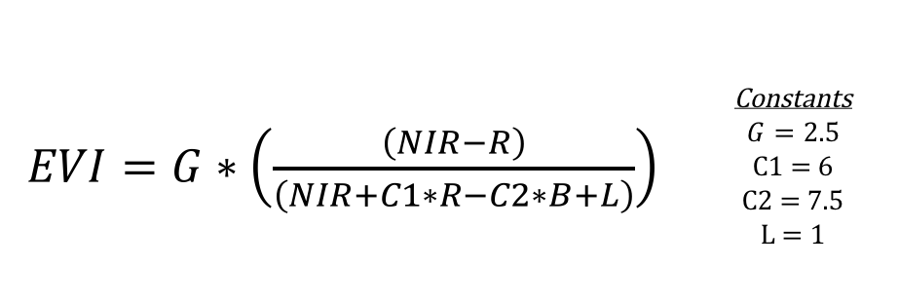
Enhanced Vegetation Index (EVI)
Can be used in place of NDVI to examine vegetation greenness
More sensitive in areas with dense vegetation, making it better for fuels assessment in dense forests
Adjusts for canopy background and some atmospheric conditions

Slide 21
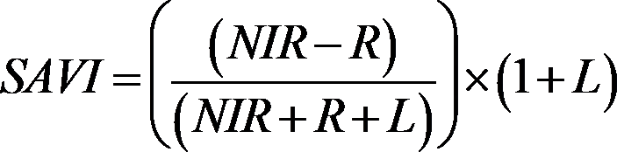
Soil Adjusted Vegetation Index (SAVI)
Used to correct NDVI for the influence of soil brightness in areas where vegetative cover is low
Better index for areas with sparse vegetation and high bare soil coverage
Contains a soil brightness correction factor (L)

Slide 22
Vegetation Index Anomalies
Anomalies are a departure of a vegetation index from the long-term average and are generated by subtracting the long-term mean from the current value for that month of the year for each grid cell.
These departures can indicate changes in vegetation health (due to drought high temperatures)

Slide 23
Vegetation Index Anomalies
Low moisture vegetation (drier fuel) is more likely to ignite and contribute to the spread of fire. Dry vegetation can also influence the moisture content of the surrounding environment.
Live Fuel Moisture Estimation: Absolute measurement of plant water content, through the Fuel Moisture Content (FMC)
FMC: The ratio of leaf water content to leaf dry-matter content
Also quantified indirectly via Evapotranspiration (ET)
Vegetation Indices: Normalized Difference Water Index (NDWI), Normalized Dry Matter Index (NDMI), Evaporative Stress Index (ESI)

Slide 24
Vegetation Structure
Radar and LiDAR remote sensing of structure: canopy height and vegetation density (canopy gaps and clumping), 3D structure of vegetation

Slide 25
Canopy Height and Density
The vertical and horizontal distribution of plant material in a forested ecosystem is a driver of fire spread.
Canopy structure influences fire dynamics directly as fuel and indirectly through its influence on other variables in the fire environment, like fuel moisture below the canopy.
Synthetic Aperture Radar (SAR) and Airborne Light Detection and Ranging (LiDAR) data can assess canopy structure over large areas.

Slide 26
Canopy Height
Forest Stand Height (FSH): Average height of trees in a forest stand
Indicator of age of forest and structure, especially the amount of Above Ground Biomass (ABG)
Can be used pre-fire to assess initial fuel availability

Slide 27
Canopy Density
Characteristic structure elements that can influence fire behavior:
Openings
Single trees
Clumps of trees with adjacent or interlocking crowns
Once areas with dense vegetation catch fire, the fire is more likely to spread given access to high fuel load.
Airborne Light Detection and Ranging (LiDAR) data can assess canopy structure over a large area.

Slide 28
Topography
Topography: Relief and landforms of the Earth’s surface
Factors that affect fire:
Elevation
Slope
Aspect (direction of the slope)
Topographic Features (canyons, ridges,bowls, etc.)

Slide 29
Elevation
Elevation Impacts:
Amount and timing of precipitation
Wind exposure
Seasonal drying of fuels
Lightning strikes
Examples: Lower elevations tend to dry out faster, thus they experience increased fire spread

Slide 30
Slope
Increased Slope = Faster Fire Spread
Slope Position: Where does the fire have room to move?
Fires that start at the bottom of the slope have greater area to spread.
As heat rises in front of the fire, it more effectively preheats and dries upslope fuels, making for more rapid combustion.

Slide 31
Aspect
Solar Radiation
Example: South- facing slopes have higher solar radiation and drier fuels.
Vegetation Type
Example: South and West facing slopes have less vegetation.

Slide 33
Topographic Features
Alter Fire Behavior
Increase Spread
Narrow and wide canyons increase wind and fire spread.
Decrease Spread
Rock outcroppings, rivers, lakes, etc. can act as barriers to spread.

Slide 34
Satellites and Sensors for Vegetation-Based Fire Applications

Slide 35
Vegetation-Based Fire Applications of Landsat and sentinel 2
Vegetation-Based Fire Applications:
Vegetation Extent and Type: Land cover classification
Vegetation Stage and Health: Variety of vegetation indices, including NDVI, EVI, SAVI
Vegetation Moisture: NDWI

Slide 36
Landsat
First Landsat launched in 1972
Landsat 8 launched in 2013
Landsat 9: was successfully launched on Monday, Sept. 27, 2021 from Vandenberg Space Force Base in California.
Multispectral, 30-meter pixels, 15-meter panchromatic band, 16-day revisit

Slide 37
Sentinel-2
Launched in June 2015
Multispectral, 10, 20, and 60- meter pixel bands, 2-5-day revisit

Slide 38
MODIS
Vegetation-Based Fire Applications:
Vegetation Extent and Type: Land cover classification
Vegetation Stage and Health: NDVI, EVI, High Temporal Resolution Phenology
Spatial Resolution:
250 m, 500 m, 1 km
Temporal Resolution:
Daily, 8-day, 16-day, monthly, quarterly, yearly
2000–Present
Spectral Coverage:
36 bands

Slide 39
Visible Infrared Imaging Radiometer Suite (VIIRS)
Vegetation-Based Fire Applications:
Vegetation Stage: VIIRS Vegetation Index include NDVI and EVI
Vegetation Health: VIIRS Vegetation Health product includes Vegetation Condition Index, Temperature Condition Index, and Vegetation Health Index
Launched in 2012; collects visible and infrared imagery
Daily temporal resolution and global coverage
Spatial Resolution: high resolution bands: 375 m 16 moderate resolution bands: 750 m

Slide 40
Soil Moisture Active Passive (SMAP)
Vegetation-Based Fire Applications:
Vegetation Moisture: Soil moisture acts as a proxy for vegetation moisture and evaporative stress.
Drought information can also identify areas with dry fuel.
Measures the moisture in the top 5 cm of the soil globally every 3 days
Launched in January 2015

Slide 41
Shuttle Radar Topography Mission (SRTM)
Vegetation-Based Fire Applications:
Topography: DEM data includes slope, aspect, elevation, and topographic feature data useful in the assessment of physical geography that influences fire risk
Topographic (elevation) data of Earth's surface, SRTM used the technique of interferometry flown onboard the Space Shuttle Endeavour
C-band and X-band, 30 m and 90 m spatial resolution

Slide 42
Sentinel-1
Vegetation-Based Fire Applications:
Vegetation Type and Extent: Land classification, fuels mapping
Vegetation Structure: Density and height
Vegetation Moisture: Fuel moisture content and dryness
European Radar Observatory for the Copernicus joint initiative of the European Commission and the European Space Agency, launched in April 2014
C-band SAR data, 12-day revisit, Resolution: 5 x 20 meters

Slide 43
Advanced Land Observing Satellite (ALOS)
Vegetation-Based Fire Applications:
Vegetation Structure: Radar measurements of canopy height and density
Topography: DEM including elevation, aspect, slope, and features
Japanese Space Agency, Phased Array L-band Synthetic Aperture Radar (PALSAR)
Dates: 2006 to 2011

Slide 44
Satellite/Sensor Overview
Satellite/Sensor | Vegetation-Based Fire Applications | Data Products
Landsat | Land Class, Vegetation Indices, Moisture | Imagery, NDVI, EVI, SAVI, NDWI
Sentinel-2 | Land Class, Vegetation Indices, Moisture | Imagery, NDVI
MODIS | Land Class, Vegetation Indices | Imagery, NDVI & EVI
VIIRS | Vegetation Indices | Imagery, Vegetation Health
SMAP | Soil Moisture | Soil Moisture
ECOSTRESS | Moisture, Evaporative Stress | Thermal Data, ESI Documentation
EO-1 Hyperion | Land Class, Dry Matter Content | Hyperspectral Imagery
AVIRIS | Land Class, Dry Matter Content | Hyperspectral Imagery
GEDI | Vegetation Structure | LiDAR Data
SRTM | Topography | Topography (DEM)
Sentinel-1 | Land Class, Structure, Moisture | Synthetic Aperture Radar Data
ALOS PALSAR | Structure, Topography | Synthetic Aperture Radar Data

Slide 45
Global Wildfire Information System (GWIS)
Joint initiative of the GEO 2017-2019 Work Programmeand Copernicus, the European service that delivers near real-time data on a global level to meet user needs.
Goal: Provide a comprehensive view and evaluation of fire regimes and fire effects at the global level
Builds on the ongoing activities of the European Forest Fire Information System, The Global Terrestrial Observing System, the Global Observation of Forest Cover –Global Observation of Land Dynamics (GOFC-GOLD) Fire Implementation team, and the associated Regional Networks
NASA recently funded several projects to enhance the current GWIS.
GWIS Viewer: https://gwis.jrc.ec.europa.eu/

Slide 46
Remote sensing types for active forest fire monitoring

Slide 47
Remote sensing types for monitoring areas damaged by forest fire
Common satellites that can provide images to map/monitor areas damaged by forest fire are,
Landsat and Sentinel-2 satellite
SPOT
Moderate Resolution Imaging Spectrometer (MODIS)
Visible Infrared Imaging Radiometer Suite (VIIRS)
ASTER Instrument

Slide 48
Active Fire Detection
Active fires are located on the basis of the so-called thermal anomalies produced by them.
The algorithms compare the temperature of a potential fire with the temperature of the land cover around it; if the difference in temperature is above a given threshold, the potential fire is confirmed as an active fire or "hot spot."

Slide 49
MODIS Active fires
The MODIS sensor, on board of the TERRA and ACQUA satellites, identifies areas on the ground that distinctly hotter than their surroundings and flags them as active fires.
The difference in temperature between the areas that are actively burning with respect to neighbor areas allows the identification and mapping of active fires.
The spatial resolution of the active fire detection pixel from MODIS is 1 km.

Slide 50
VIIRS Active fires
The VIIRS (Visible Infrared Imaging Radiometer Suite) on board of the NASA/NOAA Suomi National Polar-orbiting Partnership (SNPP) uses similar algorithms to those used by MODIS to detect active fires.
The VIIRS active fire products complements the MODIS active fire detection and provides an improved spatial resolution, as compared to MODIS.
The spatial resolution of the active fire detection pixel for VIIRS is 375 m.
Additionally, VIIRS is able to detect smaller fires and can help delineate perimeters of ongoing large fires.

Slide 51
When interpreting the hotspots displayed in the map, the following must be considered:
Hotspot location on the map is only accurate within the spatial accuracy of the sensor
Some fires may be small or obscured by smoke or cloud and remain undetected
The satellites also detect other heat sources (not all hotspots are fires)

Slide 52
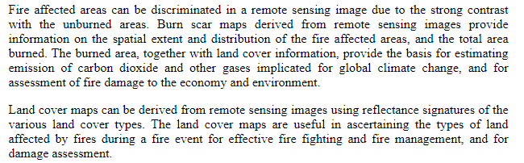
Mapping Burned Areas

Slide 53
Mapping Burned Areas
Fire affected areas can be discriminated in a remote seining image due to the strong contrast with the unburned areas.
Burn scare maps derived from remote seining images provide information on the spatial extent and distribution of the fire affected areas, and the total area burned.

Slide 54
Mapping Burned Areas
The burned area, together with the land cover information, provides the bases for estimating emission of carbon and other gases implicated for global climate change, and for assessment of fire damage to the economy and environment.
The land cover maps can be derived from remote sensing images using reflectance signature of the various land cover types. The land cover maps are useful in ascertaining the types of land affected by fires during a fire event for effective fire fighting and fire management, and for damage assessment.

Slide 55
Option 1: using classification images before and after forest fire
For burn mapping the satellite imagery should be moderate spatial coverage, high to moderate resolution, and a low turnaround time (temporal resolution)
For fire detection and monitoring, the remote sensing data required to have a large spatial coverage, moderate resolution and a very quick turnaround (temporal resolution) to facilitate response.
Comparing burned areas to active fire areas provides information as to the rate and direction of movement of the fire. Remote sensing data can also facilitate route planning for both access to, and escape from, a fire, and supports logistics planning for firefighting and identifying areas not successfully recovering following a burn.

Slide 56
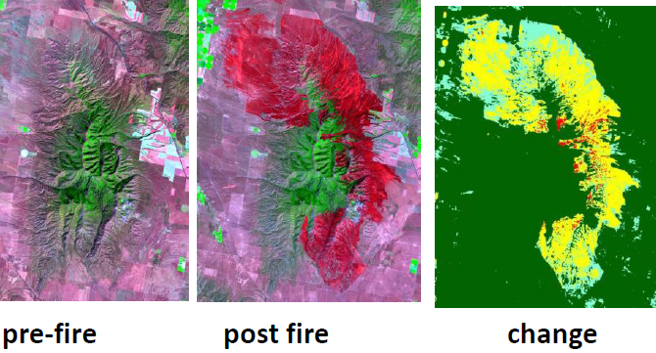

Slide 57
Option 2: using Normalized Burn Ratio (NBR)
The Normalized Burn Ratio (NBR) is used during the process as it highlights burned areas in large fire zones. After creating the pre-fire and post-fire NBR images, the post-fire image is subtracted from the pre-fire image to create a differenced (or delta) NBR (dNBR) image.
dNBR can then be used for burn severity assessment after being classified according to the burn severity ranges proposed by United States Geological Survey (USGS)

Slide 58
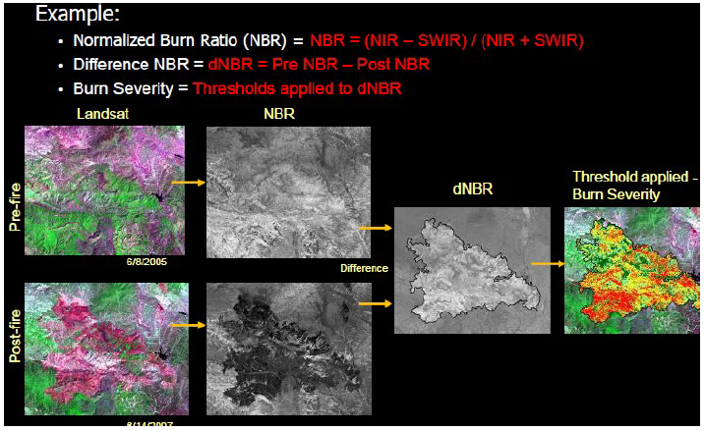

Slide 59
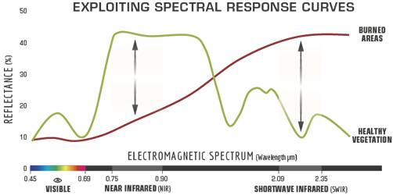
Option 2: using Normalized Burn Ratio (NBR)
Healthy vegetation shows a very high reflectance in the NIR, and low reflectance in the SWIR portion of the spectrum - the opposite of what is seen in areas devastated by fire.
Recently burnt areas demonstrate low reflectance in the NIR and high reflectance in the SWIR, i.e. the difference between the spectral responses of healthy vegetation and burnt areas reach their peak in the NIR and the SWIR regions of the spectrum.

Slide 61
Comparison of the spectral response of healthy vegetation and burned areas
To benefit from the magnitude of spectral difference, NBR uses the ratio between NIR and SWIR bands, according to the formula shown below.
A high NBR value indicates healthy vegetation while a low value indicates bare ground and recently burnt areas.
Non-burnt areas are normally attributed to values close to zero.

Slide 62
Comparison of the spectral response of healthy vegetation and burned areas
The difference between the pre-fire and post-fire NBR obtained from the images is used to calculate the delta NBR (dNBR or ∆NBR), which then can be used to estimate the burn severity.
A higher value of dNBR indicates more severe damage, while areas with negative dNBR values may indicate regrowth following a fire.

Slide 63
dNBR
dNBR values can vary from case to case, and so, if possible, interpretation in specific instances should also be carried out through field assessment; in order to obtain the best results.
The United States Geological Survey (USGS) proposed a classification table to interpret the burn severity.

Slide 64
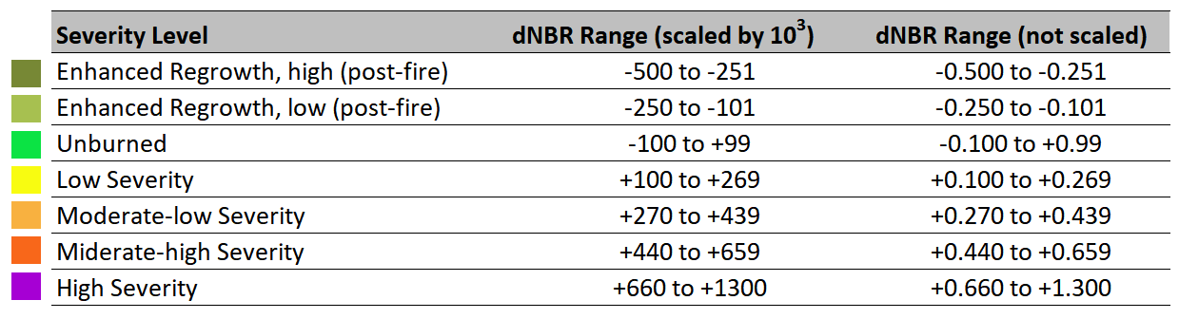
Burn severity levels obtained calculating dNBR, proposed by USGS.

Slide 65
Burn severity
Burn severity data and maps can aid in developing emergency rehabilitation and restoration plans - post-fire.
They can be used to estimate not only the soil burn severity, but the likelihood of future downstream impacts due to flooding, landslides, and soil erosion.

Slide 66
Monitoring burnt areas
RS can be used to assess the land cover situation of areas affected by forest fire (years following a fire).
Years following a fire, updates on the health and regenerative status of an area can be obtained by a single image.
Multitemporal scenes can illustrate the progression of vegetation from pioneer species back to a full forest cover or the type of land use

Slide 67
Remote sensing types for monitoring areas damaged by forest fire
Question: Briefly describe the methods for monitoring areas affected by forest fire (e.g. in 2010). The methods should show the general steps and the type of remote sensing data to be used for burn mapping and monitoring of areas affected by forest fire .

Slide 68
Remote sensing types for monitoring areas damaged by forest fire
Answer: The general procure includes: image selection, classify the images, analysis of change and area summary
Select appropriate images: For monitoring the forest fire affected area, images from three points in time are required. These includes:
The first image some time before the forest fire occurred = T1
The second image is immediately after the forest fire = T2
The third image is some years after the forest fire = T3
Classify the images using training samples (supervised classification): The classification of the second image should consider the burnet areas. Recode the classes of each classified map into comment classes.
Perform change analysis focusing on areas affected by forest fire
Produce area summary table and map layouts focusing on areas that were affected by the forest fire.

Slide 69
Limitations
Satellite fire detection has some limitations that must be kept in mind when examining the daily fire images:
The tests used by the fire algorithms to remove "false alarms" sometimes fail, leading to false records of fires.
The algorithms cannot detect fires through thick cloud or smoke. A large fire may therefore go undetected for several days and then appear or reappear later; a small fire may burn and die out without ever being detected.

Slide 70
Limitations
The time lapse between satellite image acquisition and image distribution on the CWFIS (Wild fire information system) site is between 1 and 7 hours, depending on the sensor and processing time. This delay, along with the coarse resolution, limits the utility of satellite detection for tactical fire operations.
The actual size of the actively burning area cannot be determined from satellite imagery. A 1-km² hotspot pixel may represent a fire as small as 100 m².
In addition, an intense fire covering an area less than 1 km² may actually show up as a cluster of several hotspot pixels. This is the result of the varying size and spatial overlap of the raw, unprojected pixels.

